Slide 1






INSURANCE MANAGEMENT SYSTEM
Group - 4

Slide 2



Team Members Kishore kumar KJ - 2527159 Komma Mounika - 2528005 Kona Himaja - 2528892 Kuldeep Sikarwar - 2526849 M Harish Kumar - 2526916 M Sanofar Jahan - 2529219 Mahibaala V - 2526809 Mansi Bindal - 2528302 Megantha P - 2526842 Mohit Kumar - 2525955

Slide 3



Project Overview
Create a dynamic and responsive web application for managing the Insurance policies online

Slide 4
INTRODUCTION We have created a bug-free application for the admin and the user with the main objective to build a secured, robust Insurance Management System where the policies are managed systematically. This web application maintains the record of customer history and policies efficiently so that it would be easily accessible.

Slide 5






Tools and Technologies
Front-End
Back-End
DataBase
Server

Slide 6



Architecture
Spring
Rest
Controller
Spring
Data
JPA
SQL
Http
client
Template
Component
Services
Client
Server

Slide 7



Modules
Admin module
User module

Slide 8
ADMIN MODULE
Create account and login into portal
view customers
View/add/update/delete policy
View/add/update/delete policy category
Approve/disapprove policy applied by customer
View all customers and their policy statements
view queries of customer

Slide 9

USER MODULE
Create account and login
Update personal details
View all policies
Apply for any policy
View policy history
Post queries
Contact US

Slide 10
Future Scope
With minor changes such as incorporation of staff portal this application can be of great use to any insurance company
the system can be used by the insurance company to keep record of policy, insurance detail, departments and various branches.
thus, depending on future requirements the web application can be upgraded accordingly

Slide 11
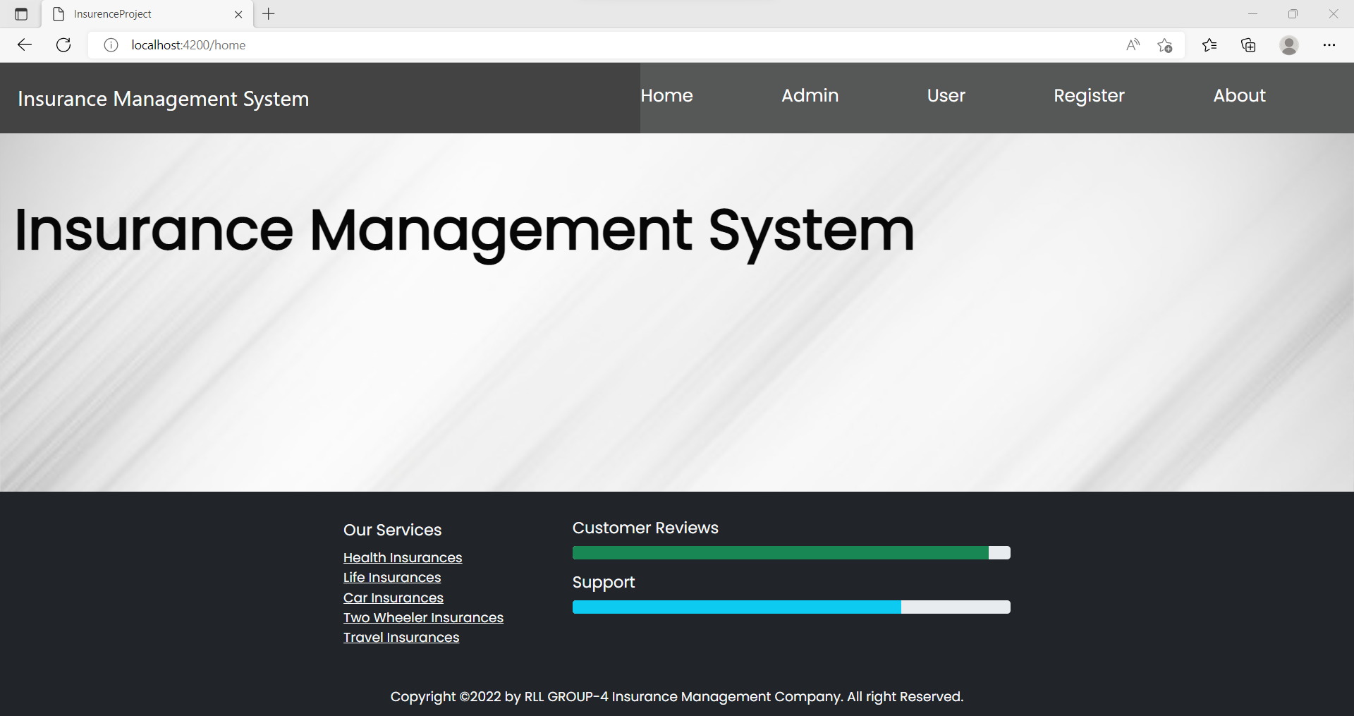
HOME

Slide 12
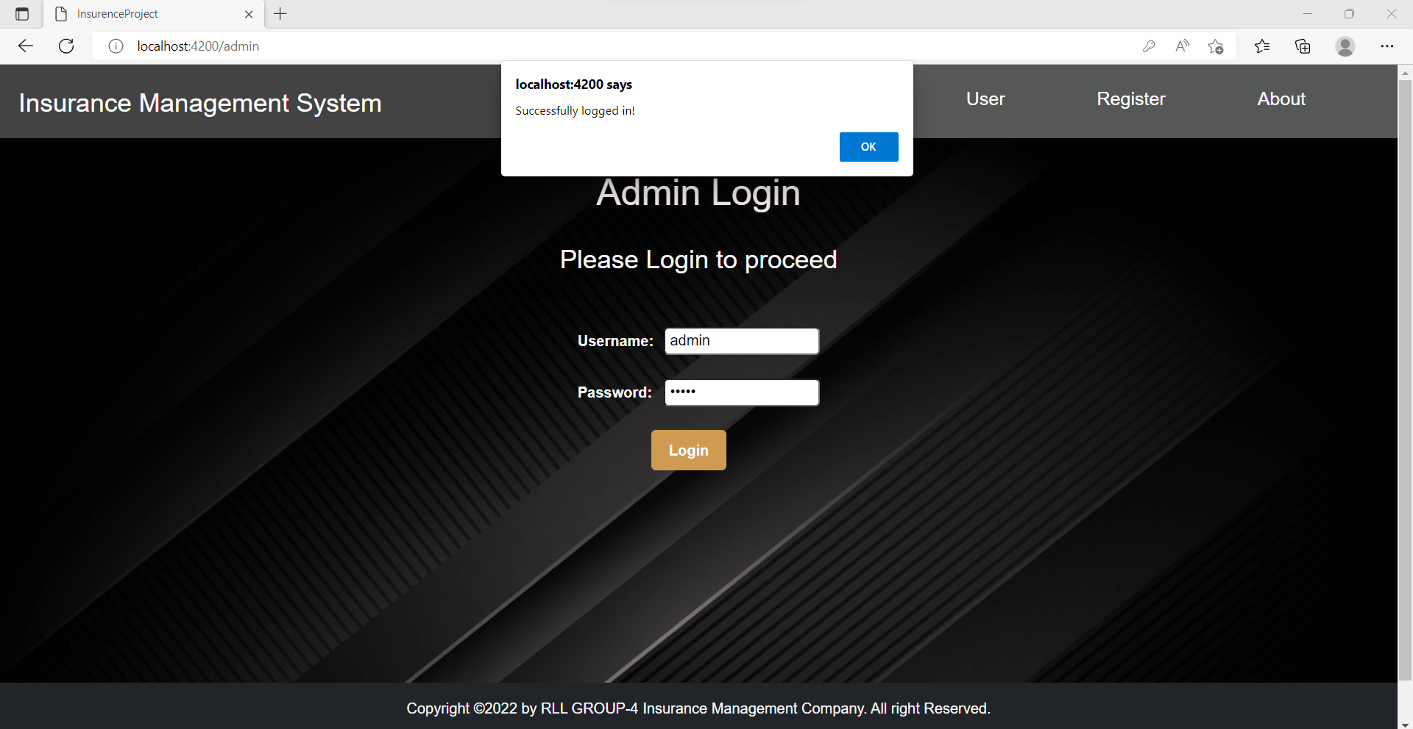
ADMIN LOGIN

Slide 13
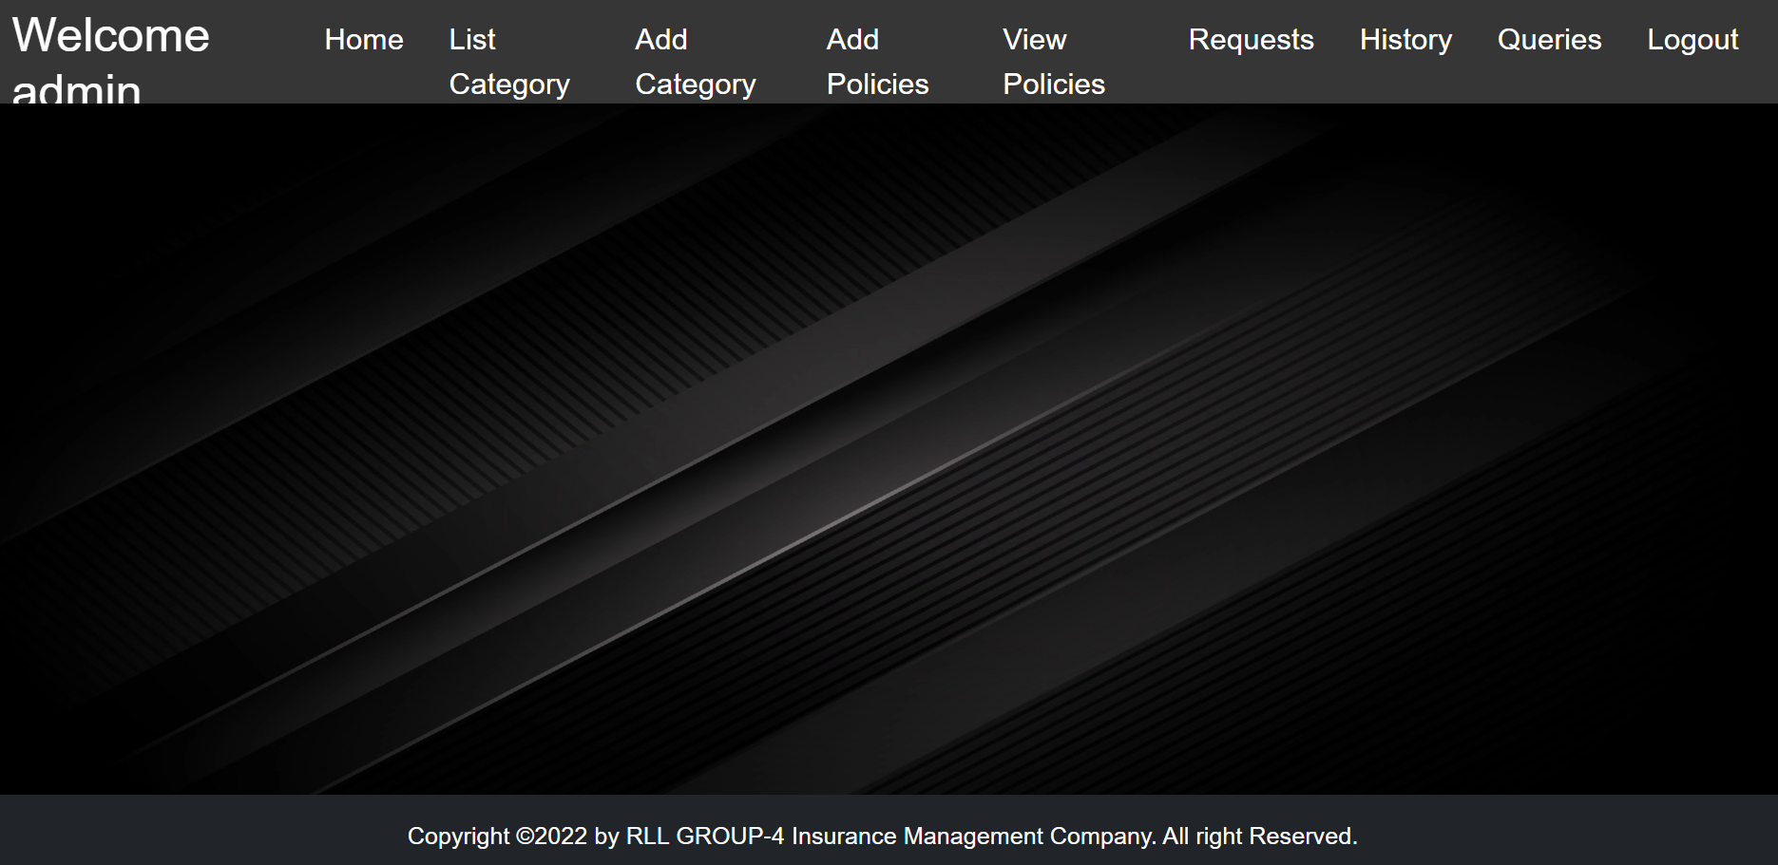
ADMIN HOME

Slide 14
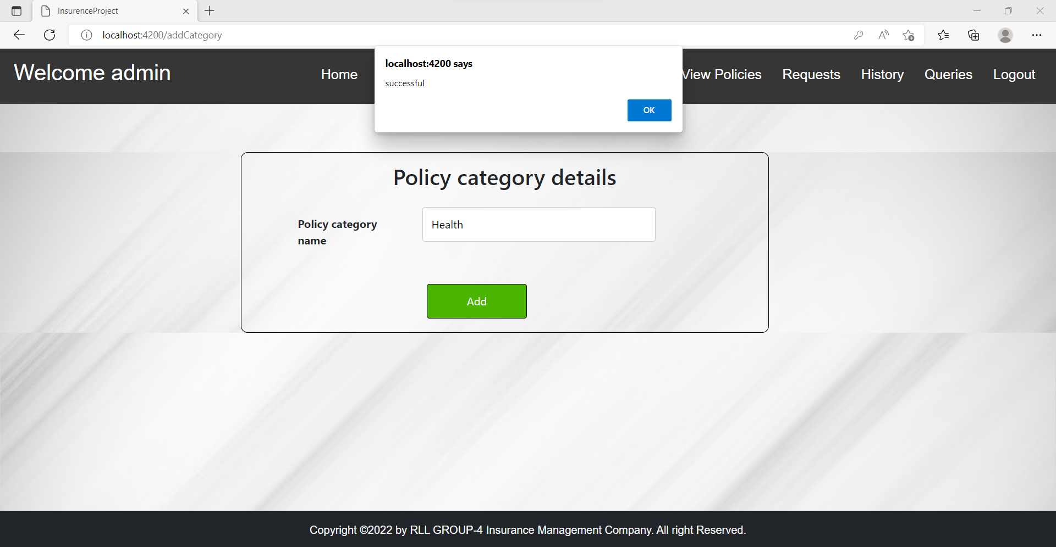
ADD CATEGORY

Slide 15
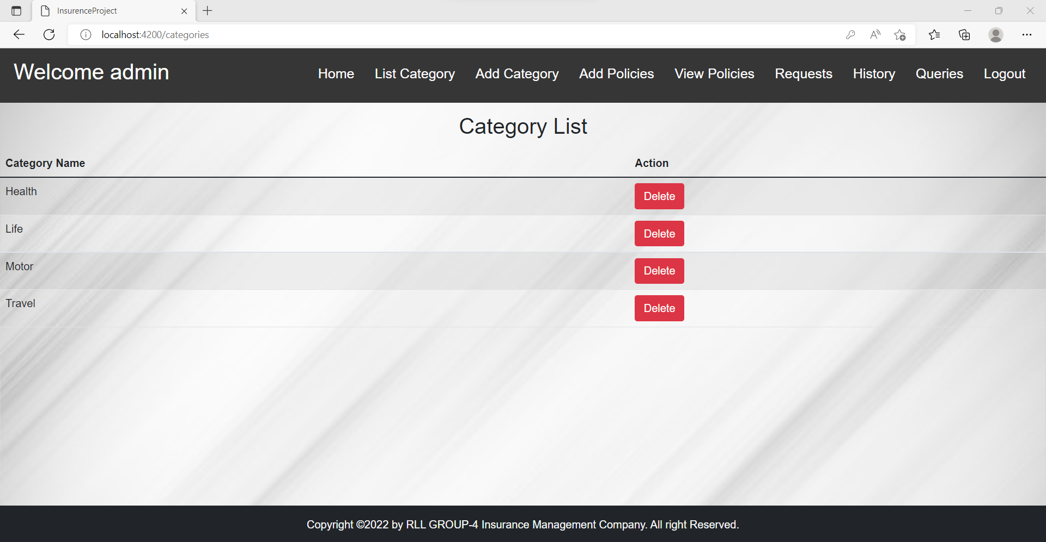
LIST CATEGORY

Slide 16
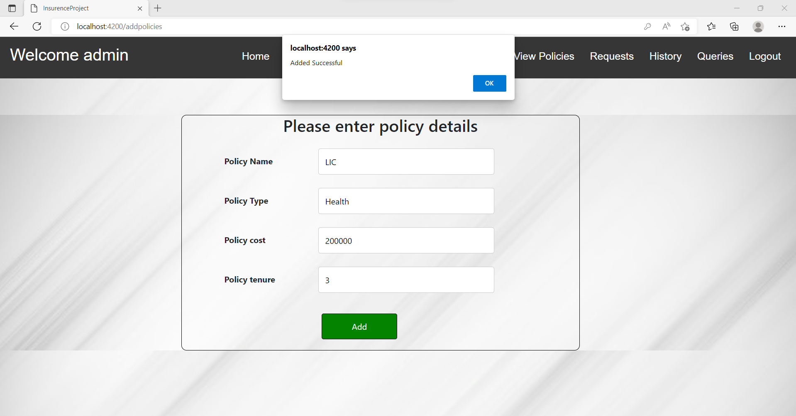
ADD POLICY

Slide 17
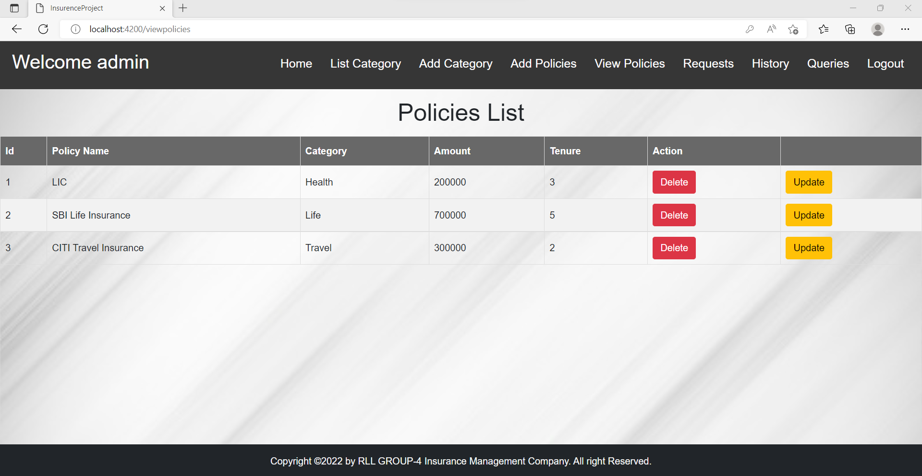
VIEW POLICIES

Slide 18
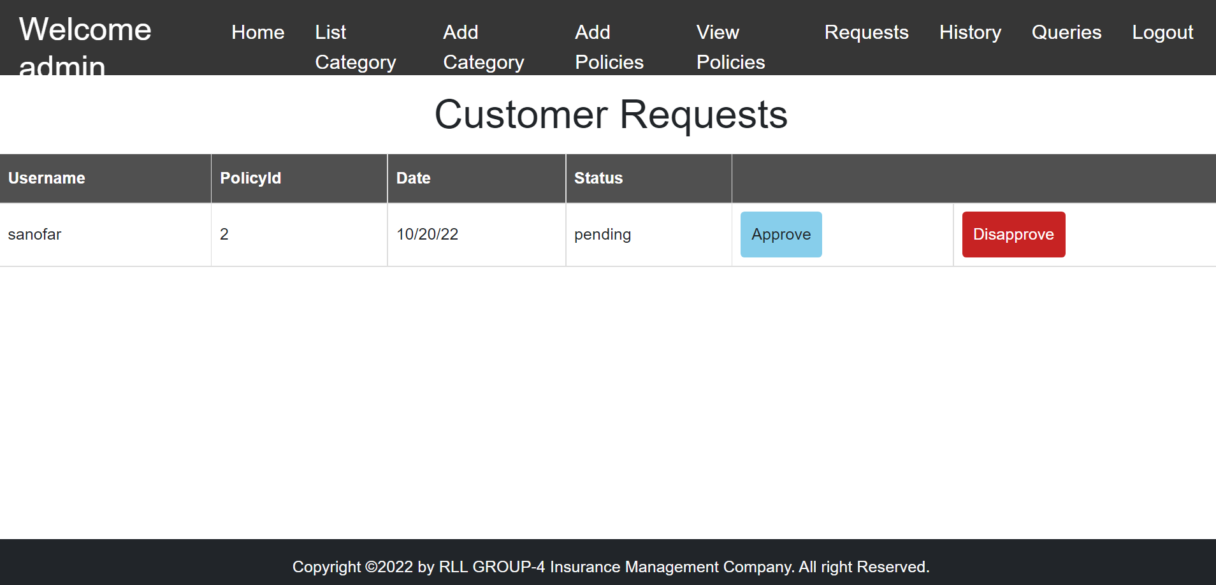
REQUESTS

Slide 19
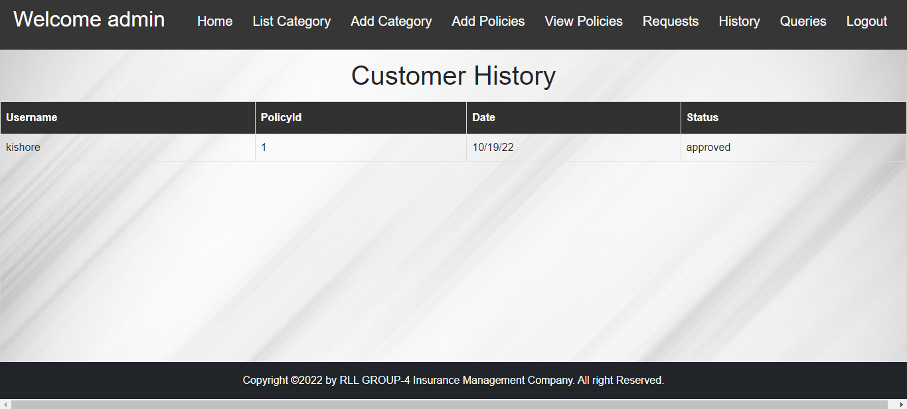
CUSTOMER HISTORY

Slide 20
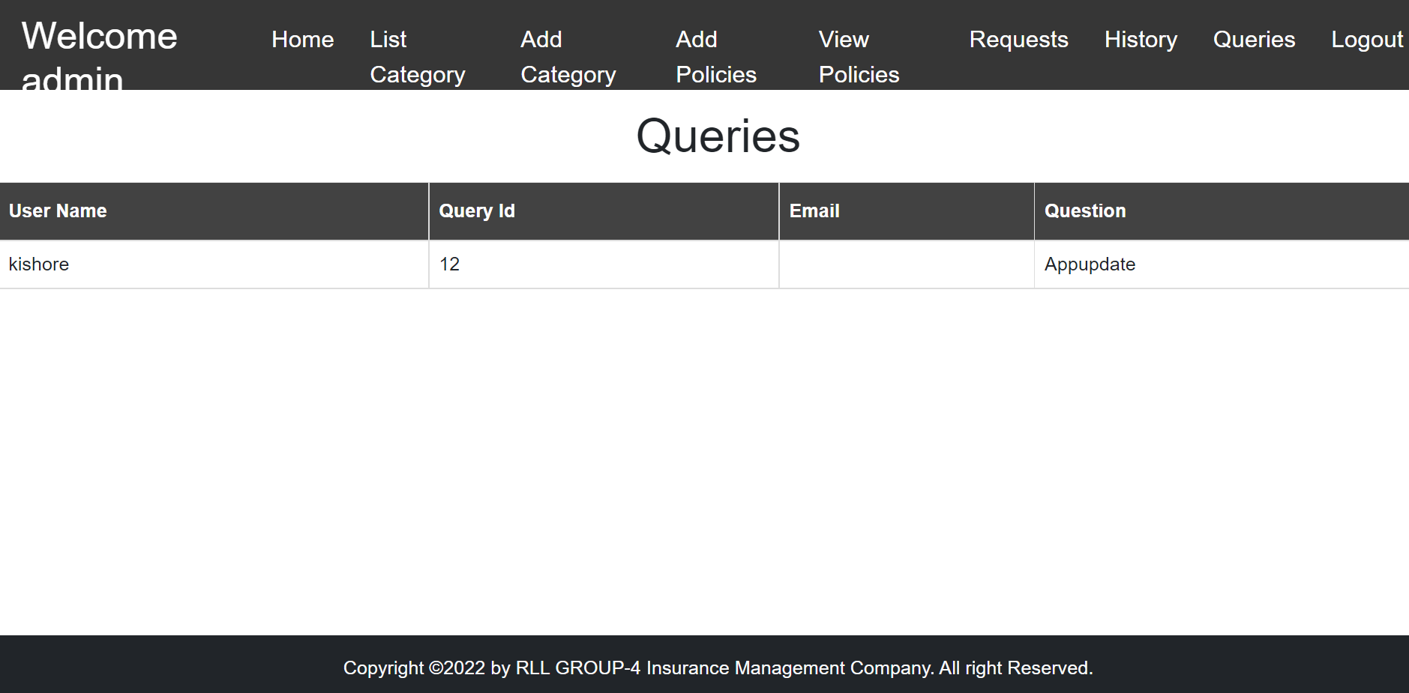
QUERIES

Slide 21
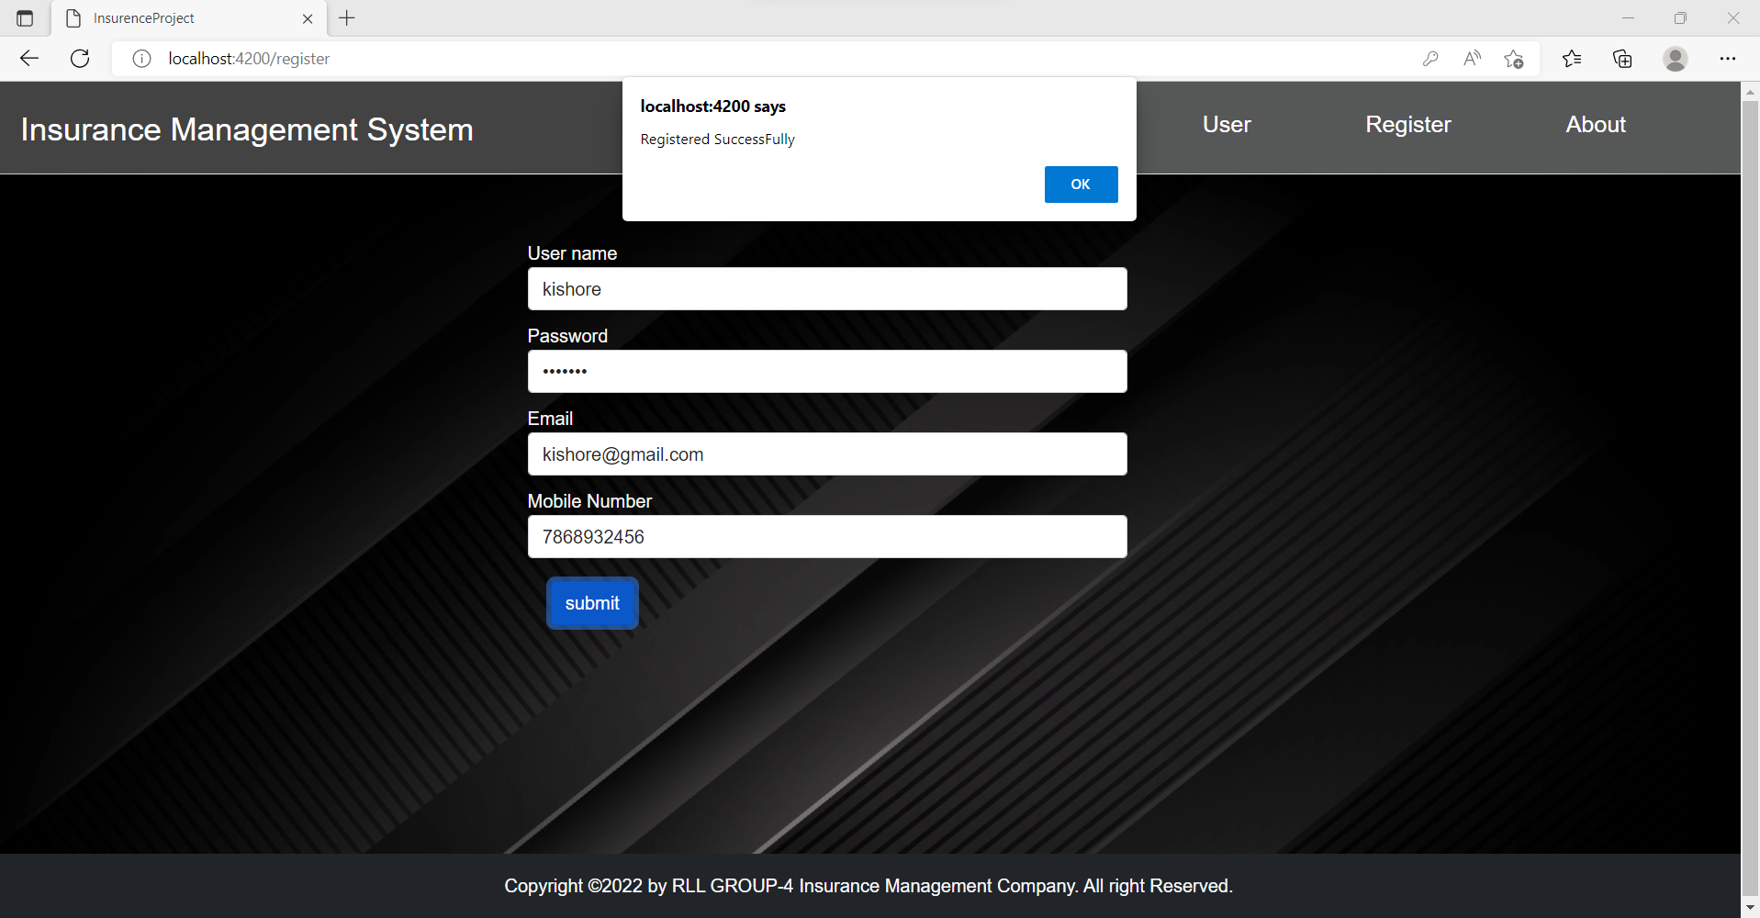
USER REGISTER

Slide 22
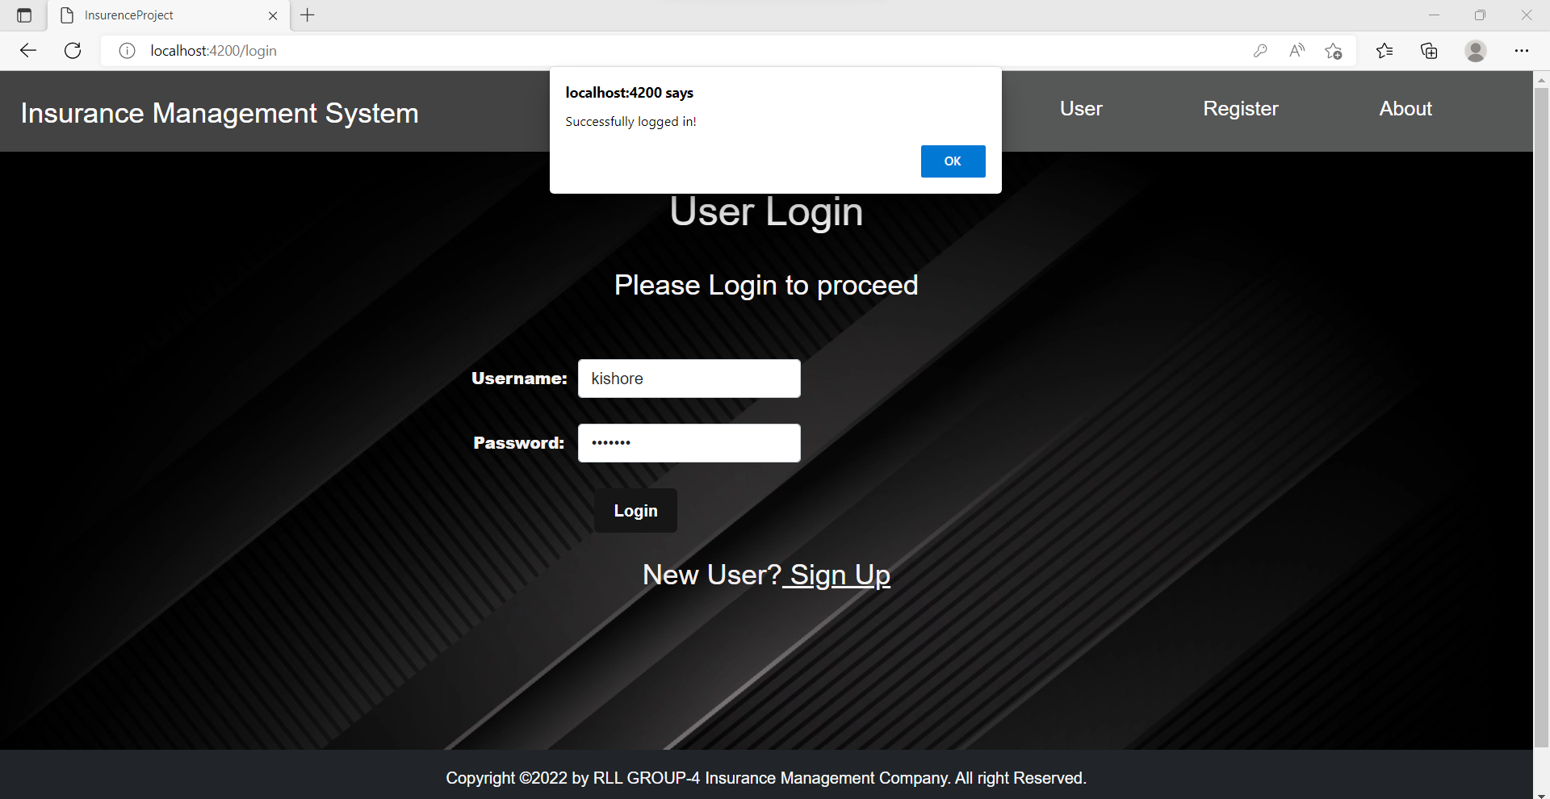
USER LOGIN

Slide 23
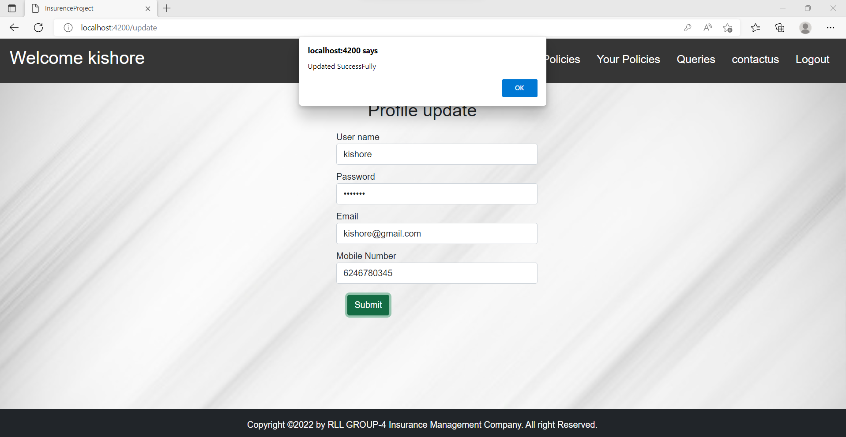
UPDATE USER PROFILE

Slide 24
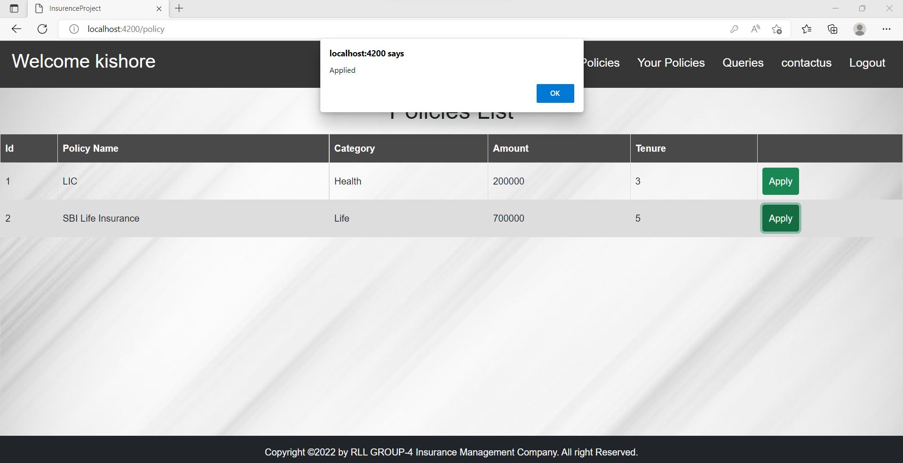
APPLY POLICIES

Slide 25
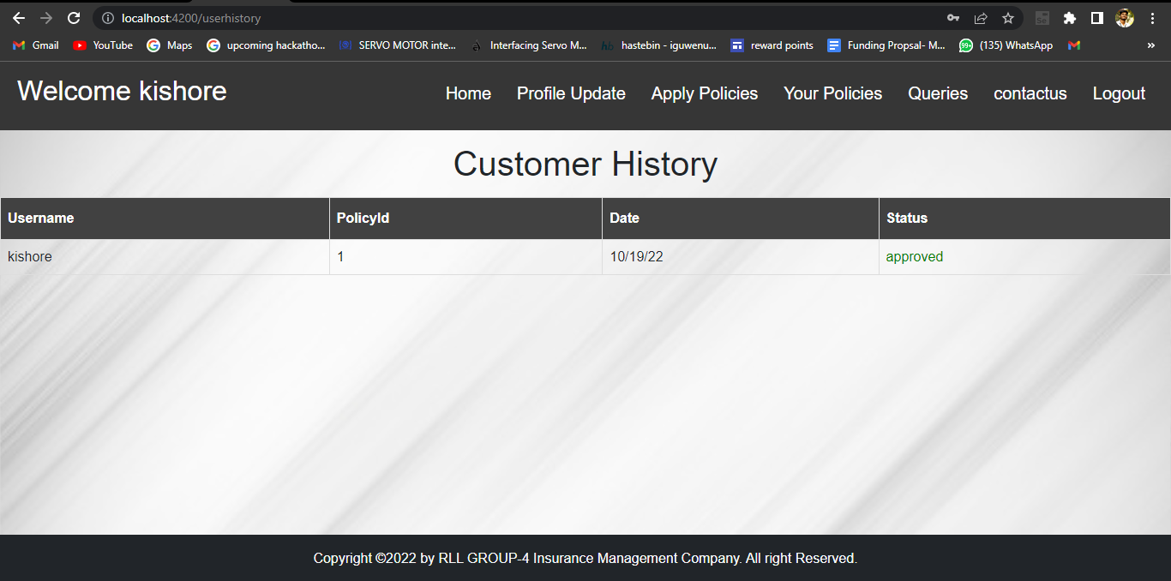
YOUR POLICIES

Slide 26
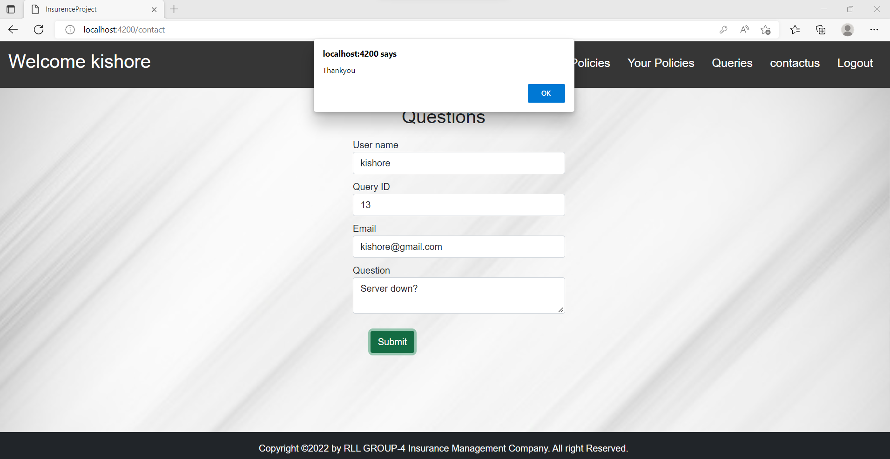
QUERIES

Slide 27
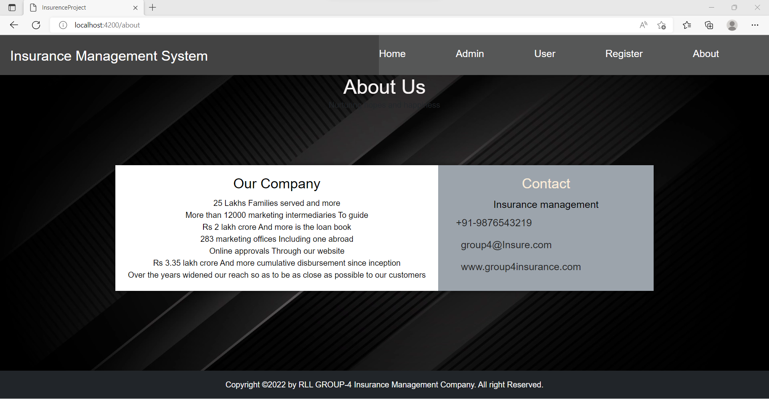
CONTACT US

Slide 28
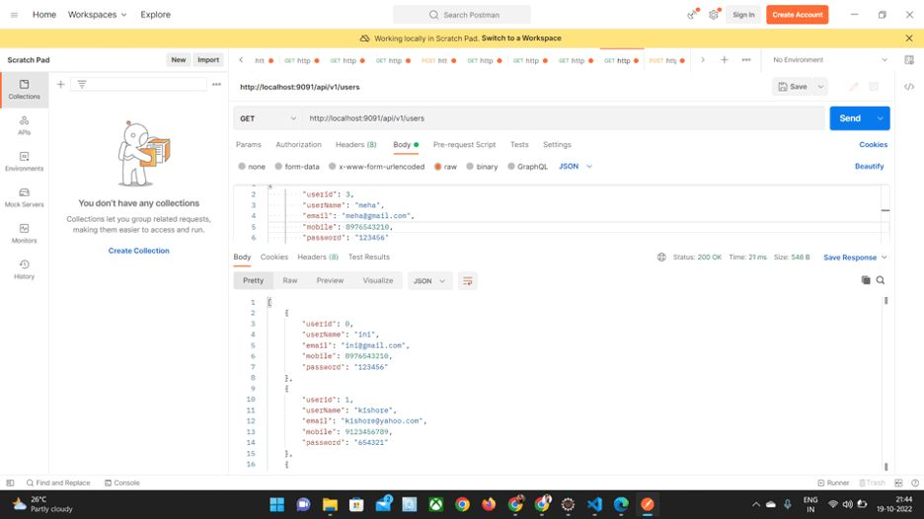
POSTMAN TESTING

Slide 29
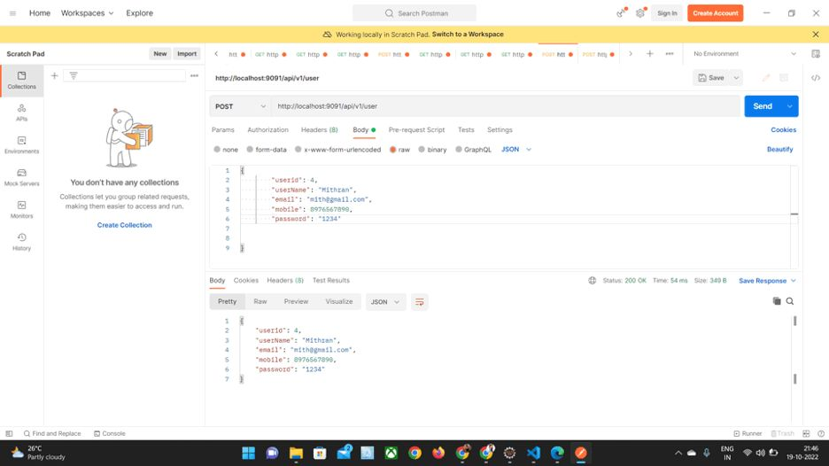

Slide 30
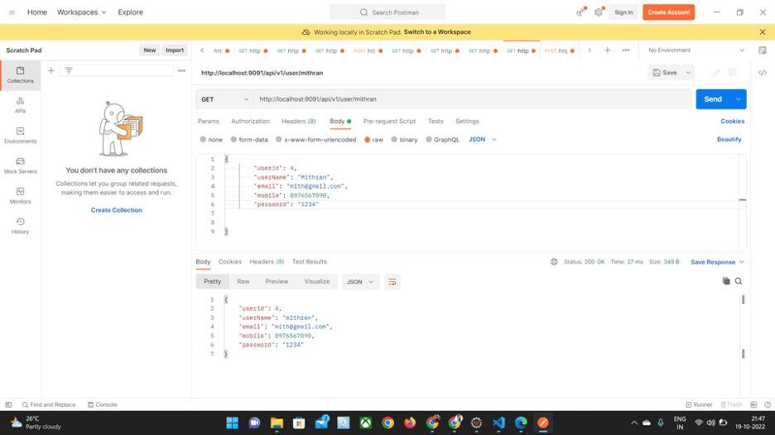

Slide 31
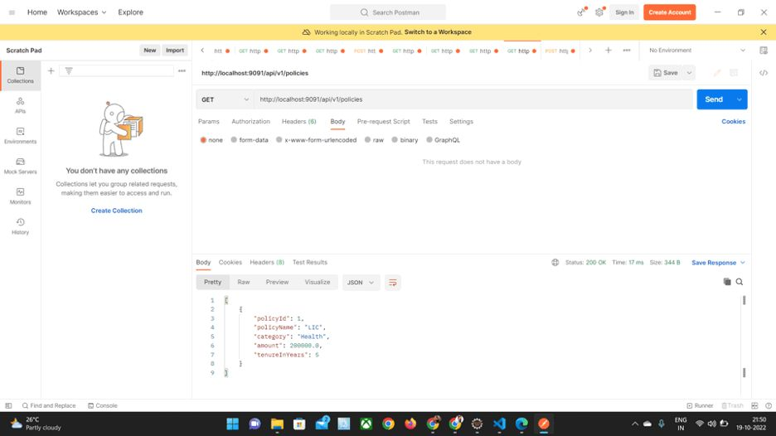

Slide 32
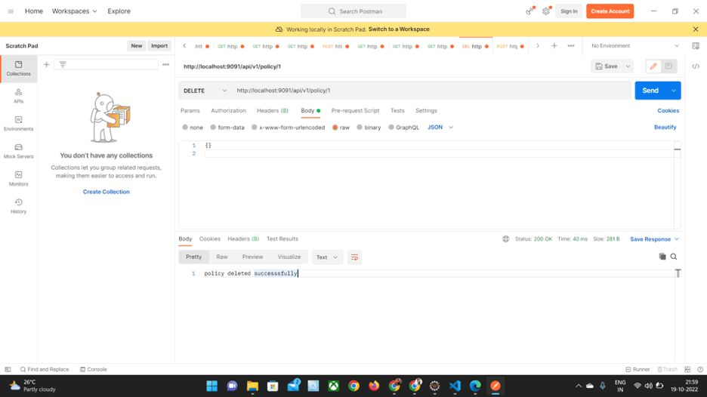

Slide 33


Slide 34
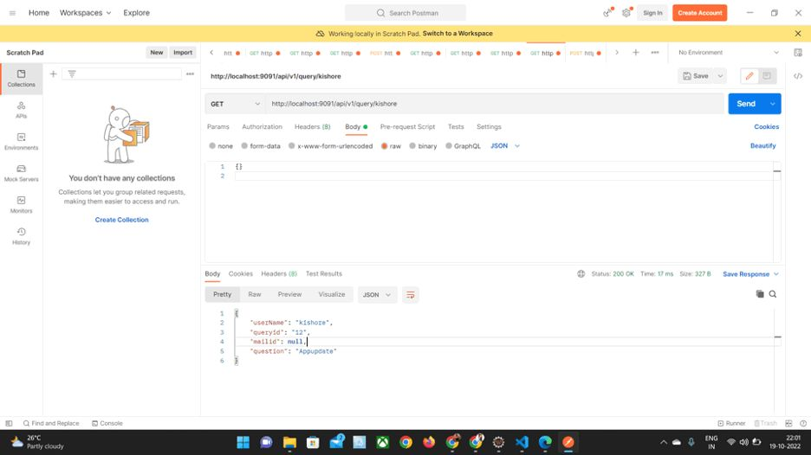

Slide 35
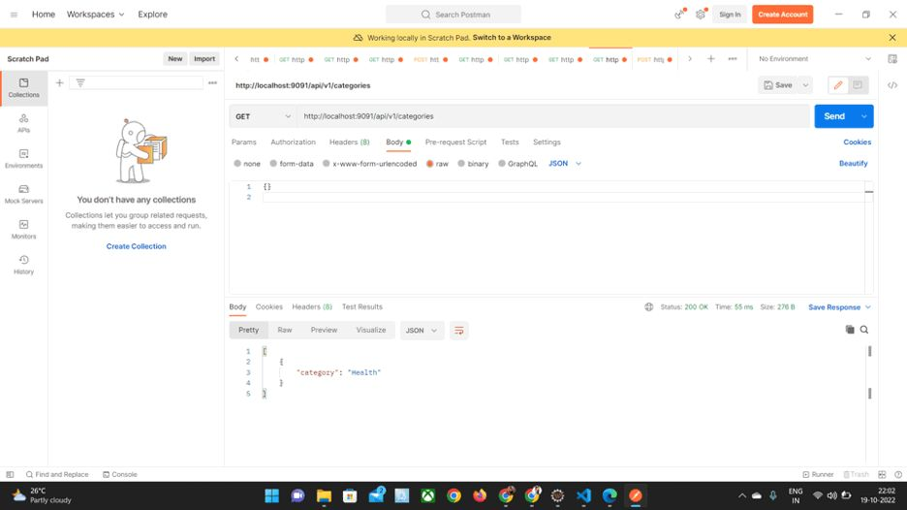

Slide 36
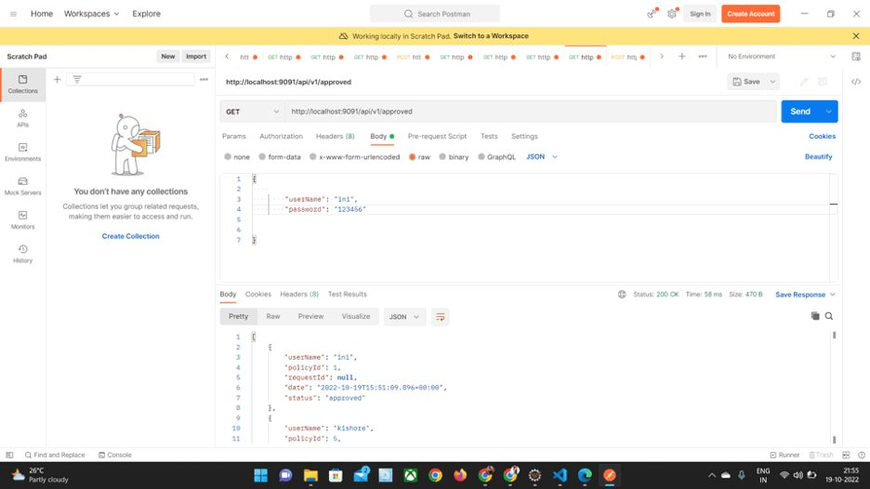

Slide 37
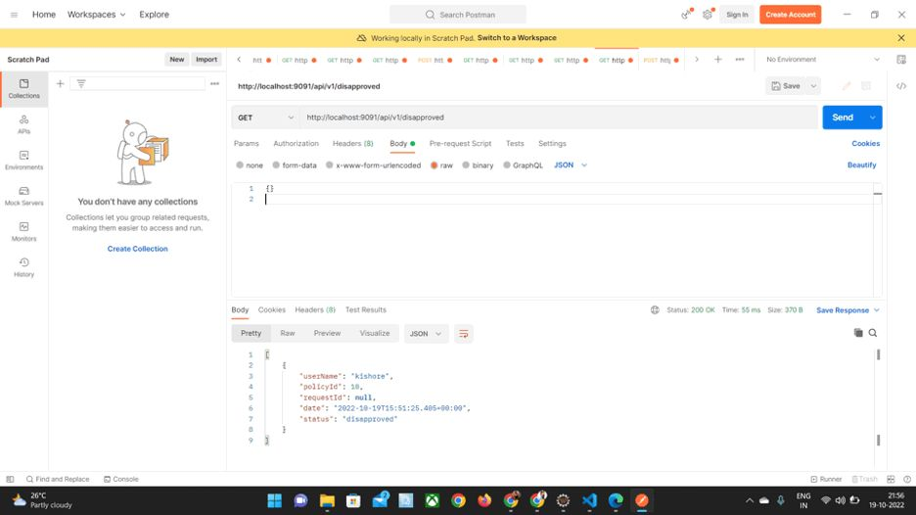

Slide 38


Slide 39


Slide 40
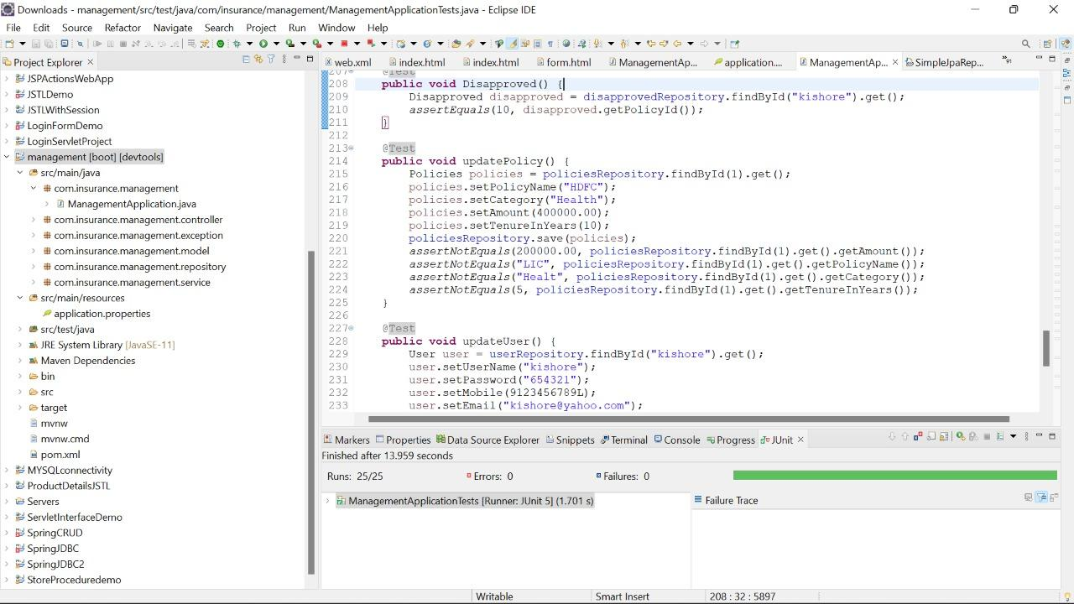
JUNIT TESTING

Slide 41

Demonstation

Slide 42





KEY TAKE AWAYS
Team work
Assess interests and abilities in Software Development
Time management
Develop communication and interpersonal skills
Integrate theory and practice

Slide 43

Thank You

